Slide 1
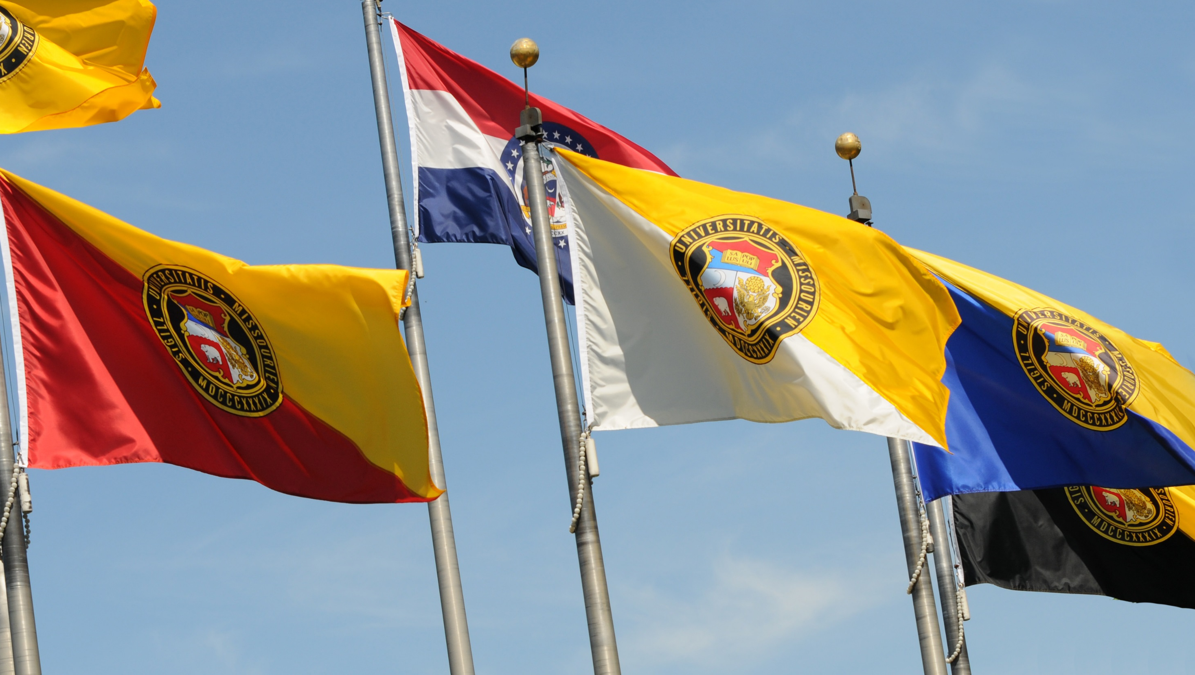

Slide 2
Carnegie Classifications
R1(Highest Research) – Mizzou (115 Universities)
R2 (Higher Research) – UMKC, S&T and UMSL (107 Universities)
Research & development (R&D) expenditures in science and engineering
R&D expenditures in non-S&E fields
S&E research staff (postdoctoral appointees and other non-faculty research staff with doctorates)
Doctoral conferrals in humanities, in social sciences, in STEM and other fields (e.g., business, education, public policy, social work)

Slide 3
2013 ASU MUP Metrics for Top 200 Institutions
 | MU | S&T | UMKC | UMSL
Total Research | $233M (55) | $26M (144)
Federal Research | $108M (64)
Endowment | $804M (40)
Annual Giving | $119M (33) |  | $36M (96)
National Academy | 8 (44)
Faculty Awards | 7 (50)
Doctorates | 390 (33) |  | 116 (104)
SAT Scores | 1170 (66) | 1260 (21)
Nat’l Merit Scholars | 30 (34) | 5 (76) | 5 (76)

Slide 4
Faculty Counts
 | 2012 | 2013 | 2014 | 2015 | 2016
MU | 1080 | 1066 | 1051 | 973 | 983
UMKC | 445 | 443 | 407 | 412 | 417
S&T | 277 | 276 | 296 | 301 | 307
UMSL | 286 | 286 | 279 | 277 | 258
Notes:
The UM System’s second core principle is excellence in research.

Slide 5
Space Deficit in 2015
 | MU | S&T | UMKC | UMSL
Academic Space Deficit | 242K | 90K* | -15K | -105K
Programs with Largest Deficits | CAS Medicine ENG | ENG | CAS Conservatory ENG | Nursing Library

Slide 6
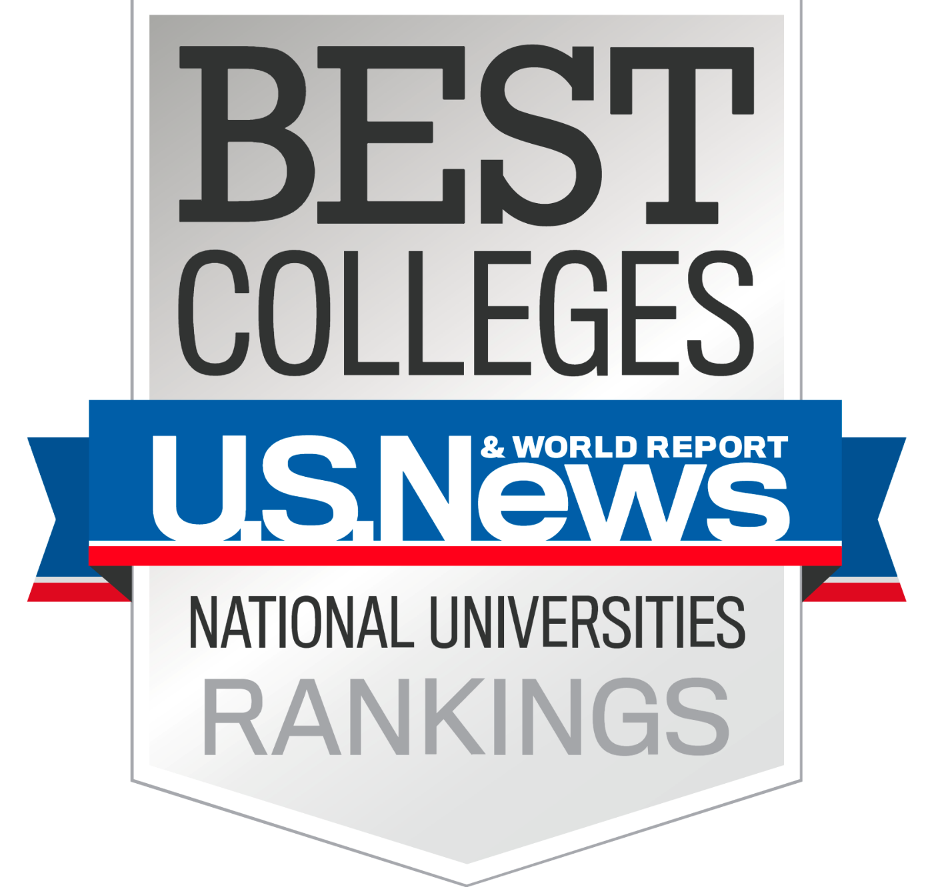

Slide 7
School | Overall rank | Acceptance rate | Student/faculty ratio | SAT Math average score | SAT Verbal average score | % of faculty who are full-time
Weight |  | 1.25% | 1.0% | 8.13% |  | 1.0%
U. of Michigan | 27 | 26.2 | 15 | 707 | 673 | 93.3
U. of Illinois | 44 | 65.6 | 18 | 733 | 627 | 99.9
U. of Wisconsin | 44 | 49.2 | 17 | 688 | 602 | 94.2
CSOM | 82 | 38 | 16 | 690 | 638 | 78
NCSU | 92 | 50.1 | 14 | 640 | 610 | 95.1
U. of Tennessee | 103 | 76.3 | 17 | 583 | 576 | 95.7
MU | 111 | 78.1 | 20 | 582 | 573 | 97.3
Missouri S&T | 164 | 88.1 | 19 | 622 | 586 | 90.2
UMKC | 210 | 62.7 | 14 | 609 | 603 | 83.3
UMSL | 220 | 75.9 | 17 | 511 | 449 | 74

Slide 8
School | Overall rank | % of classes with 50 or more students | % of classes with fewer than 20 students | % of freshmen in top 10 % of HS class | Average freshman retention rate | 6-year Grad rate | Graduation rate Perf rank
Weight |  | 4.0% | 4.0% | 3.13% | 4.5% | 18.0% | 7.5%
U. of Michigan | 27 | 16.5 | 57.2 | 73 | 97 | 90 | 159
U. of Illinois | 44 | 19.7 | 40.9 | 53 | 93.5 | 85 | 101
U. of Wisconsin | 44 | 21.1 | 45.1 | 54 | 95.3 | 85 | 84
CSOM | 82 | 25.5 | 20.8 | 56 | 92 | 77 | 166
NCSU | 92 | 17.1 | 35.2 | 51 | 93 | 76 | 84
U. of Tennessee | 103 | 14.1 | 27.8 | 54 | 85.8 | 70 | 184
MU | 111 | 17.3 | 40.1 | 28 | 85.3 | 69 | 131
Missouri S&T | 164 | 26.7 | 26.7 | 44 | 84.3 | 65 | 255
UMKC | 210 | 10.6 | 54.9 | 32 | 72.3 | 52 | 276
UMSL | 220 | 6.1 | 51.4 | 29 | 76.8 | 41 | 292

Slide 9
School | Overall rank | % of full-time faculty with terminal degree | Faculty compensation rank | Average alumni giving rate | Financial resources rank | HS counselor score | Peer assessment score
Weight |  | 3.0% | 7.0% | 5.0% | 10.0% | 7.5% | 15.0%
U. of Michigan | 27 | 90.6 | 59 | 18.6 | 40 | 4.4 | 4.4
U. of Illinois | 44 | 93.5 | 29 | 9.5 | 55 | 3.9 | 3.9
U. of Wisconsin | 44 | 91.5 | 82 | 13.1 | 63 | 4 | 4
CSOM | 82 | 84 | 54 | 14.4 | 103 | 4.3 | 3.3
NCSU | 92 | 92.4 | 125 | 12.3 | 98 | 3.6 | 3.1
U. of Tennessee | 103 | 87 | 59 | 9.9 | 72 | 3.7 | 3.1
MU | 111 | 91 | 133 | 15.1 | 176 | 3.6 | 3.2
Missouri S&T | 164 | 91.3 | 110 | 14.8 | 200 | 3.5 | 2.6
UMKC | 210 | 76.2 | 244 | 6.3 | 171 | 3.2 | 2.5
UMSL | 220 | 74.5 | 244 | 4.9 | 230 | 3.2 | 2.4

Slide 10
Comparisons with Peers
 | CSOM | S&T | UA-Huntsville
Faculty | 194 | 180 | 57
NTT | 60 | 39 | 17
UG Students (FT) | 4,359 | 5,162 | 1,865
MS Students (FT) | 570 | 373 | 109
PhD Students (FT) | 506 | 438 | 105
Research | $48M | $25M | $43M

Slide 11
Institution | Number of UG Students | Percent Pell Recipients Among UG Students | Percent URM Among UG Students | Net Price for Low-Income Students-($0-30K) | 2013 6-Year Pell Grant Recipient Grad Rate | 2013 6-Year Non-Pell Grant Recipient Grad Rate
University of Illinois | 32,281 | 20.2 | 13.0 | $7,954 | 78.4 | 84.9
Indiana University | 32,371 | 19.4 | 8.3 | $4,632 | 64.3 | 78.9
University of Michigan | 27,979 | 15.7 | 8.6 | $5,529 | 81.5 | 91.0
MU | 26,960 | 21.6 | 11.4 | $12,731 | 57.9 | 72.6
UMKC | 10,614 | 32.1 | 20.4 | $15,522 | 35.0 | 58.4
Missouri S&T | 5,841 | 25.9 | 7.1 | $11,127 | 55.5 | 64.5
UMSL | 13,335 | 30.4 | 17.6 | $9,757 | 37.8 | 49.4
Ohio State University | 43,058 | 22.2 | 9.6 | $10,026 | 74.3 | 85.0

Slide 12
S&T UG Students Total:5,411 Unduplicated Headcount FY2016 All Terms

Slide 13
S&T UG Pell Students Total:1,536 Unduplicated Headcount FY2016 All Terms

Slide 14
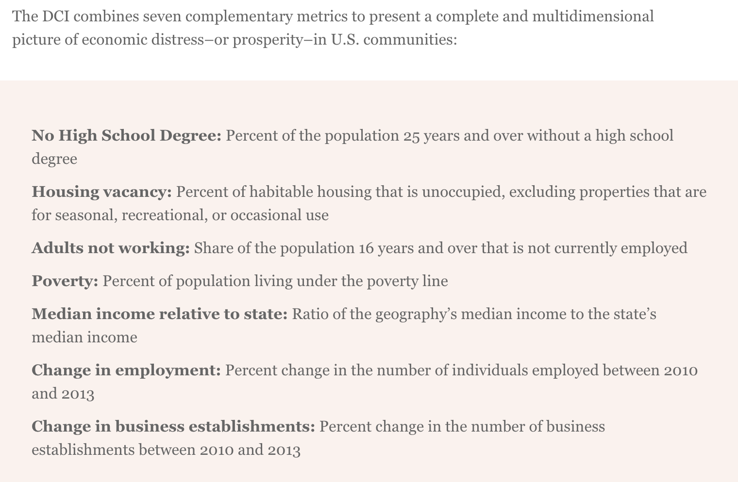
Distressed Communities Index

Slide 15
How Can UM and MU Support REDI?

Slide 16
Strategic Investments – S&T
7 strategic faculty hires in:
Communication
Biology
Physics
Engineering
ACML Building
Staff hires for:
Teaching and research support
Advising
Advanced Construction and Materials Laboratory

Slide 17
Faculty Hiring
 | All | MU | UMKC | S&T | UMSL
Tenured/ Tenure-Track | 98 | 70 | 15 | 5 | 8
Non-Tenure Track | 114 | 91 | 10 | 2 | 11
Total | 212 | 161 | 25 | 7 | 19

Slide 18
Strategic Objectives
Create an institution that meets high standards of excellence in education, research, engagement and economic development for MO and beyond
Create an inclusive framework of background, experience and thought that values each Missourian
Create programs and an environment that promote student learning & success; faculty research & impact; student and faculty engagement with MO citizens
Create measure of accountability for all stakeholders to contribute to UM System vision
Eliminate barriers of personalities, processes, practices and policies that hinder collaborations and progress

Slide 19
Hiring a New Chancellor
What makes S&T an attractive institution?
What do we need to improve at S&T?
How can you contribute to attract outstanding chancellor?

Slide 20
Thank you
www.umsystem.edu

